Slide 1



Enhancing Kenya Power's Prepaid Electricity Experience
A Bluetooth-Enabled Smart Customer Interface Unit (CIU) Integrated with the My Power Mobile Application
Presented by
Kahindi Padii Gandi
Android & Embedded Systems Developer
KCA University
Notes:
RedLucent.Thread

Slide 2
About Me
I am an undergraduate Computing student at KCA University with an interest in Android development, Embedded Systems, and Internet of Things (IoT).
Over the past several months, I have researched Kenya Power's prepaid electricity ecosystem and developed a working prototype demonstrating how Bluetooth Low Energy (BLE) can improve customer interaction with existing prepaid Customer Interface Units (CIUs) without replacing current infrastructure.
Notes:
RedLucent.Thread

Slide 3
Problem statement
Current Customer Challenges
• Customers frequently forget to monitor remaining electricity units.
• Unexpected power interruptions occur due to depleted tokens.
• Manual entry of 20-digit prepaid tokens is inconvenient.
• Customers must be physically present near the CIU to monitor usage.
• Existing CIUs provide valuable information but cannot share it with customers' smartphones.
Result
Reduced customer convenience despite existing digital payment channels.
Notes:
RedLucent.Thread

Slide 4
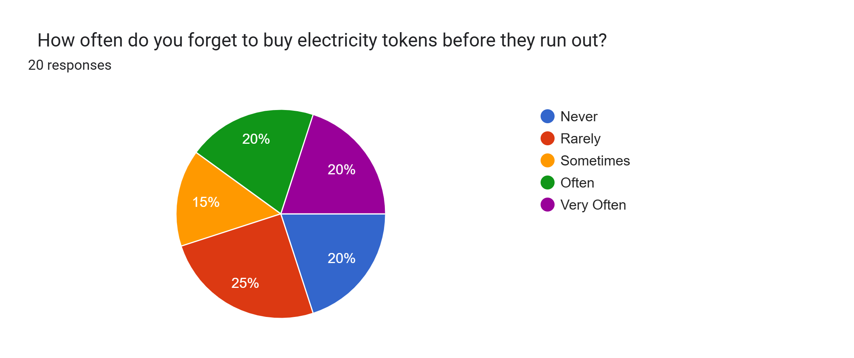
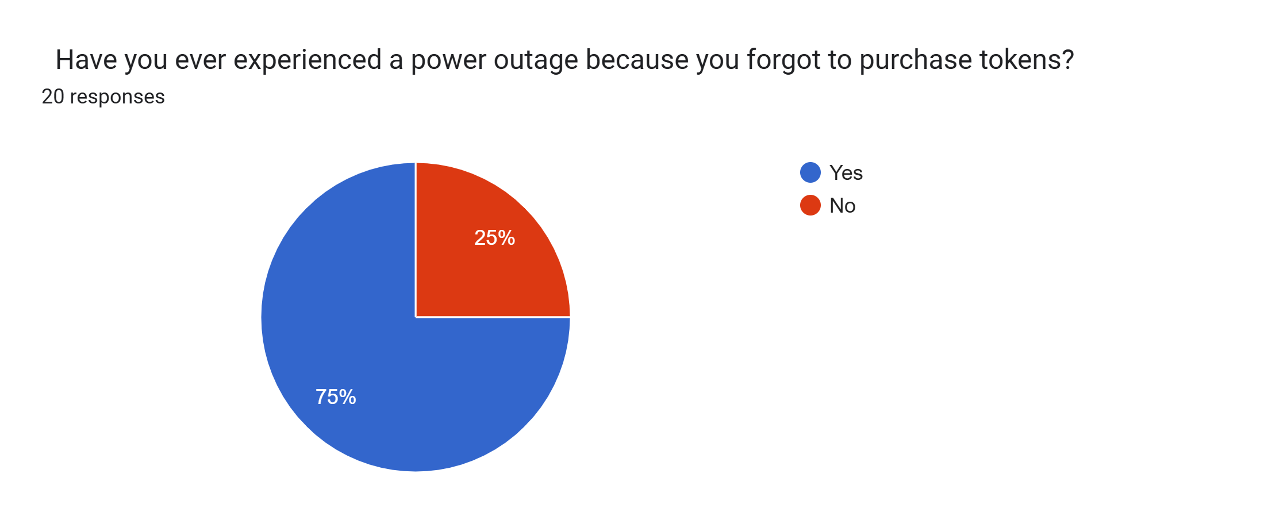
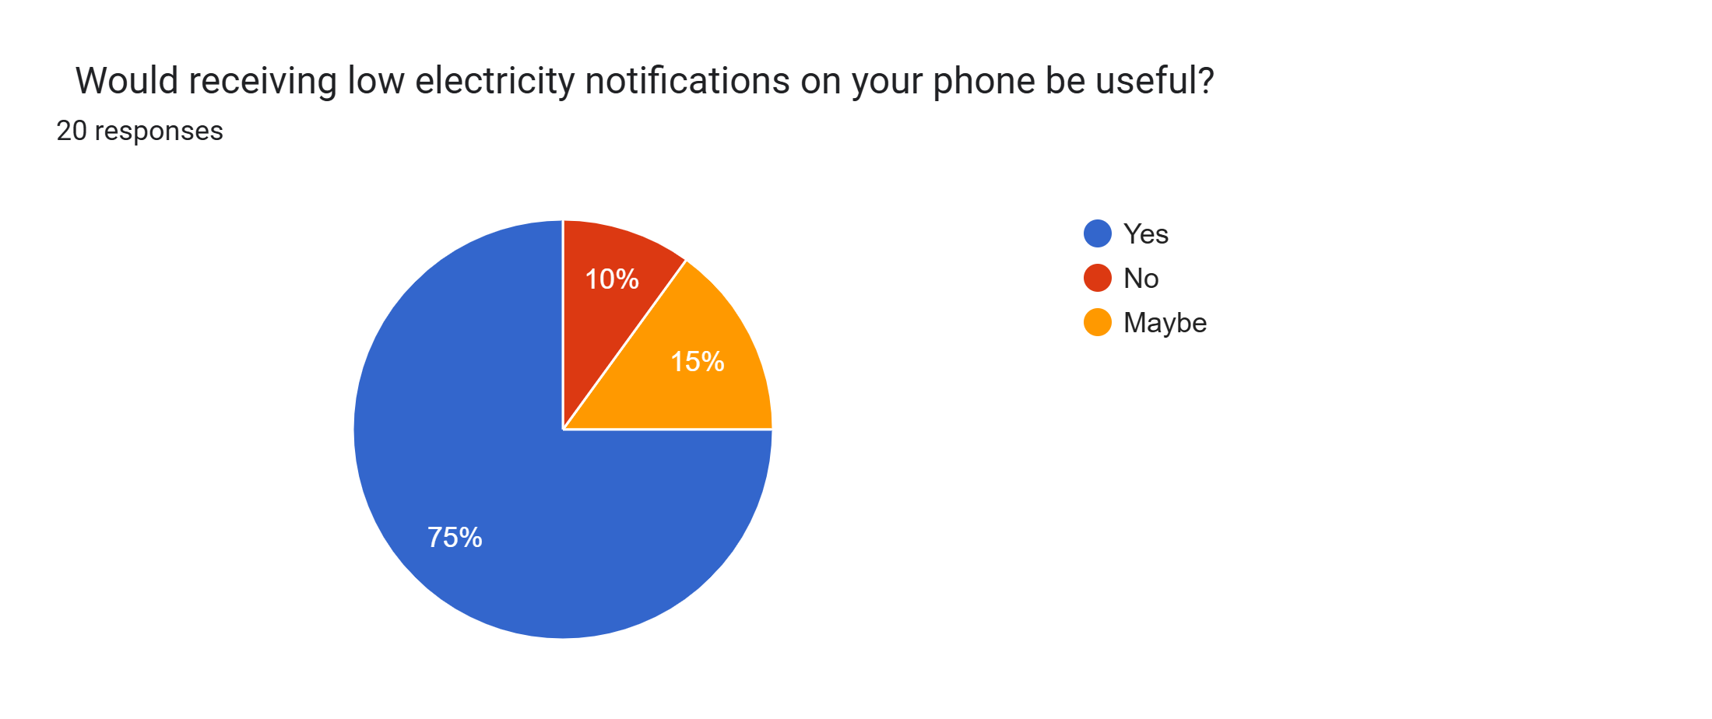
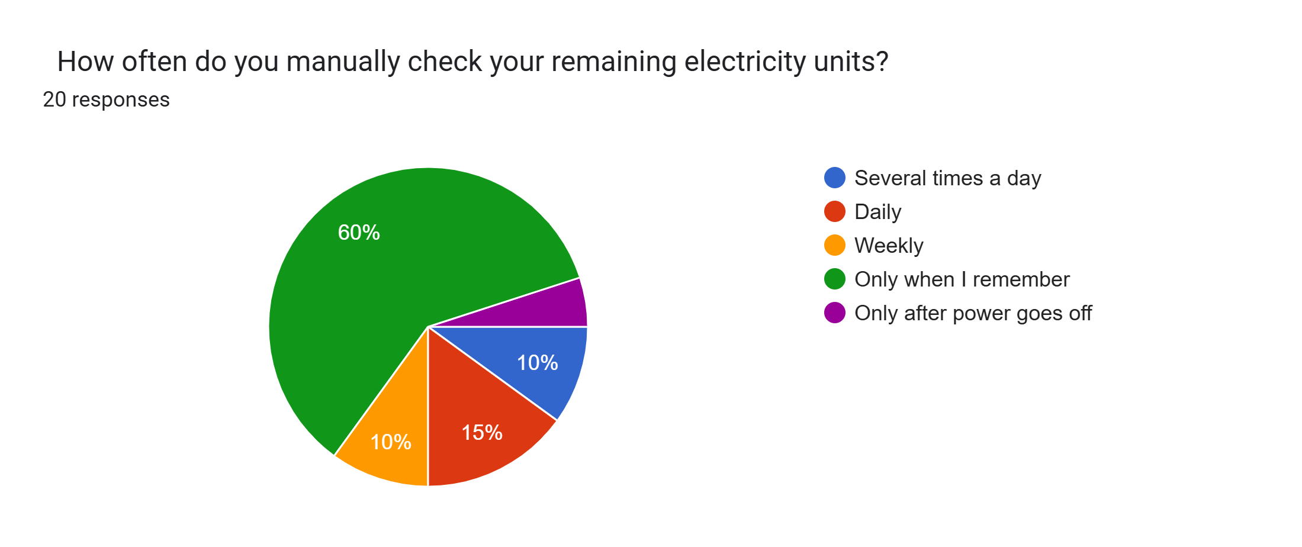
Why This Matters
Notes:
RedLucent.Thread
FullSurvery: https://docs.google.com/forms/d/1zJQ485wjTawfngITmvj4dOr__dEiIh5-IZ78f5_edqU/edit#responses

Slide 5
Current Process
Buy Tokens
Receive tokens
Enter 20-digit code manually
Power restored

Slide 6
Proposed Solution
Customer
My-Power App
Bluetooth
BLE-enabled CIU
Existing Meter

Slide 7
Features
SMART MONITORING
Remaining Units
NOTIFICATIONS
Low Balance Alerts
ANALYTICS
Daily Consumption
ASSISTED TOKEN LOADING
Automatic Token Transfer

Slide 8
Benefits to Kenya Power
CUSTOMER BENEFITS
✔ Better user experience
✔ Accessibility
✔ Reduced manual errors
✔ Convenience
KENYA POWER BENEFITS
✔ Supports Tuende Digital
✔ Increased My-Power engagement
✔ Backward compatible
✔ Future-ready platform

Slide 9
Implementation Strategy
PHASE ONE
PROTOTYPE
PHASE TWO
PILOT
PHASE FOUR
FINAL ROLLOUT
PHASE THREE
INTERGRATION

Slide 10
Future Opportunities
• Smart notifications
• Usage analytics
• Smart home integration
• Predictive electricity purchasing
• Enhanced customer engagement
AI

Slide 11
Closing
This proposal demonstrates how Kenya Power can enhance the existing prepaid electricity experience by leveraging Bluetooth Low Energy technology while preserving the current prepaid infrastructure.
Thank You

